Slide 1
Skookum IT Solutions
Dante De La Riva, Shaun Bennett, Christian Calhoun, Kincaid Young

Slide 2

Skookum IT Solutions
Small business, only 4 employees, combined 50 years experience
Previous projects
-implemented similar solutions for legal firms, and other tax offices
Maybe a mission statement

Slide 3


Slide 4

Agenda
Summary of requirements
Calhoun- Summary of Billing
Shaun- Summary of Document Transfer
Kincaid- Summary of Advertisement
Dante- Summary of Cost and Timeline

Slide 5
Solution Goal
Faster spread of the knowledge of Tax Boss and its services to new clientele.
Secure transfer of sensitive documents between Tax Boss and its clientele.
An automated system to track time spent and bill clients for this time.
A system allowing clients to schedule meetings with Tax Boss.
A notification system alerting Tax Boss to upcoming events, such as meetings.

Slide 6

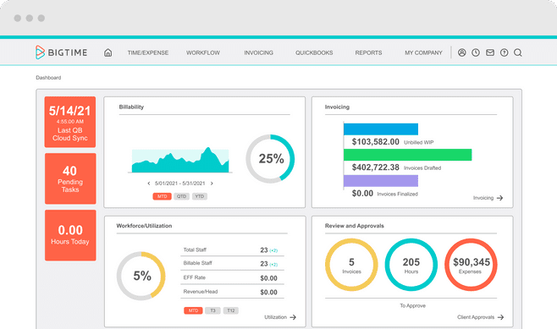
Track and Bill expenses and Time
Custom Invoices
Manage projects and budgets
Integrates with Google, QuickBooks, Salesforce and others
Gmail. Meeting, schedule automatically added to the calendar

Slide 7

Google Workspace
Safe Transfer of Files
Creation of forms
Google Drive
Business Email

Slide 8
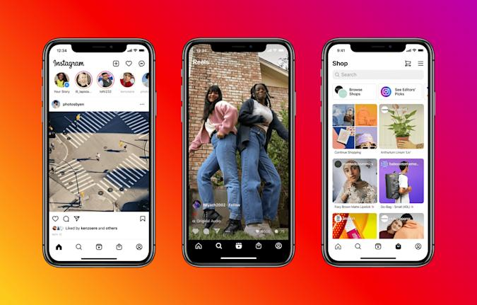
Advertising- Social Media
Instagram –
More personal
Multiple ways to post – stories, regular posts, reels , etc.
Facebook –
Better target audience
Better algorithms
Less expensive ads

Slide 9
Cost
External Cost | Purpose | Price Year 1 | Price Year 2 | Price Year 3
Google Workspace | Document Transfer | $144 | $144 | $144
BigTime (Pro) | Time Keeping, Billing, Notifications | $1,800 | $1,800 | $1,800
Shookum | Advertisement Creation | $3,000 | $2,000 | $2,000
Meta Advertising | Advertisement Display | $2,000 | $2,000 | $2,000
Internal Cost
Training | Training in Solutions Above | $1,000 | $0 | $0
Total |  | $7,944 | $5,944 | $5,944

Slide 10
Timeline
 | Week 1 | Week 2 | Week 3 | Week 4 | Week 5
Google Workspace
BigTime
Shookum
Meta Advertising
Implementation
Training
Testing

Slide 11
Conclusion
Google Workspace provides a great experience for transferring sensitive documents between businesses and clients.
BigTime allows easy time management, billing, and notifications.
Meta Advertising allows fast and simple methods for advertising to Instagram and Facebook.
We, Shookum, will give our best to deliver great quality advertising.
We’re ready to take the next steps when you are!

